Slide 1
CONSTRUCTING ANN
Determine the network properties:
Network topology
Types of connectivity
Order of connections
Weight range
Determine the node properties:z
Activation range
Determine the system dynamics
Weight initialization scheme
Activation – calculating formula
Learning rule

Slide 2
PROBLEM SOLVING
Select a suitable NN model based on the nature of the problem.
Construct a NN according to the characteristics of the application domain.
Train the neural network with the learning procedure of the selected model.
Use the trained network for making inference or solving problems.

Slide 3
NEURAL NETWORKS
Neural Network learns by adjusting the weights so as to be able to correctly classify the training data and hence, after testing phase, to classify unknown data.
Neural Network needs long time for training.
Neural Network has a high tolerance to noisy and incomplete data.

Slide 4
SALIENT FEATURES OF ANN
Adaptive learning
Self-organization
Real-time operation
Fault tolerance via redundant information coding
Massive parallelism
Learning and generalizing ability
Distributed representation

Slide 5
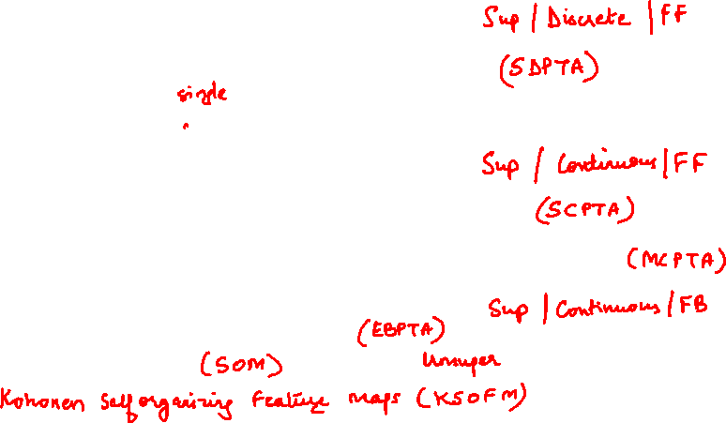
Training Algorithms
Discrete Perceptron Training Algorithms
Single discrete perceptron training algorithm
Multi-perceptron layer training algorithm
Continuous training algorithm
Single continuous perceptron training algorithm
Multicategory single-layer perceptron training algorithm
Error back propagation training algorithm
Self-organizing maps

Slide 6
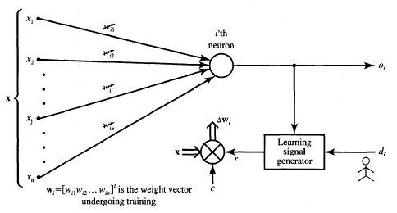
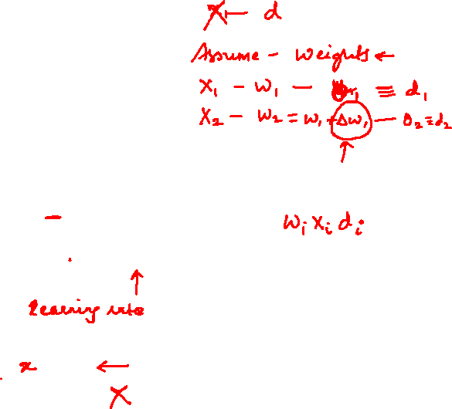
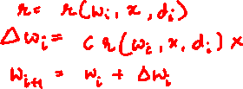
NN Learning rules/algorithms
The learning signal r is a function of w_{i},x, and sometimes of the teacher's signal d_{i}.

Slide 7
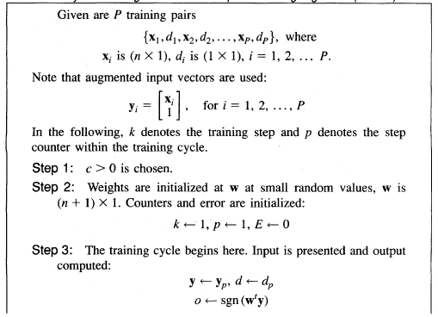
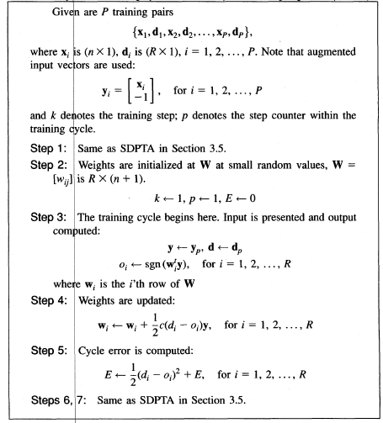
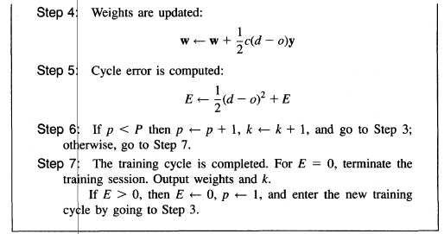
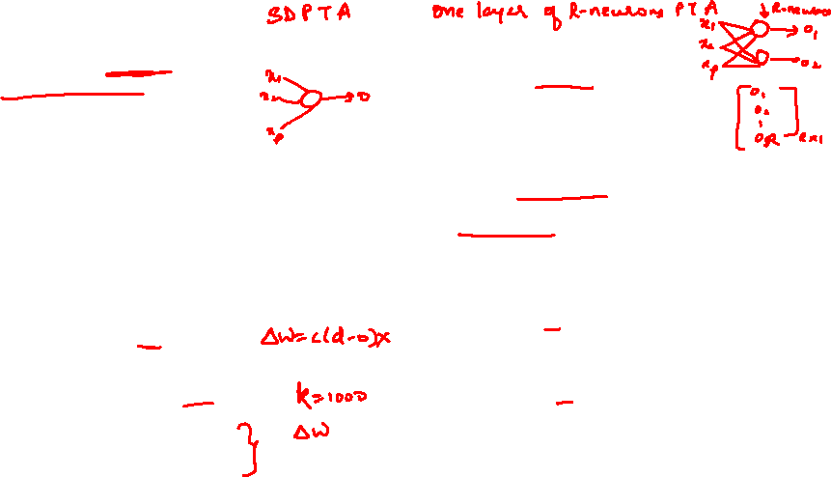

Slide 8
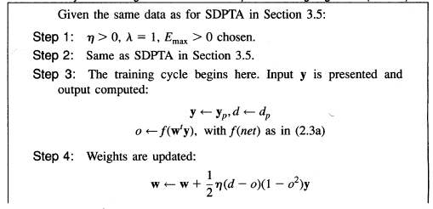
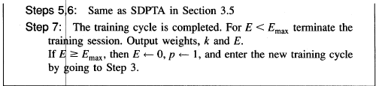
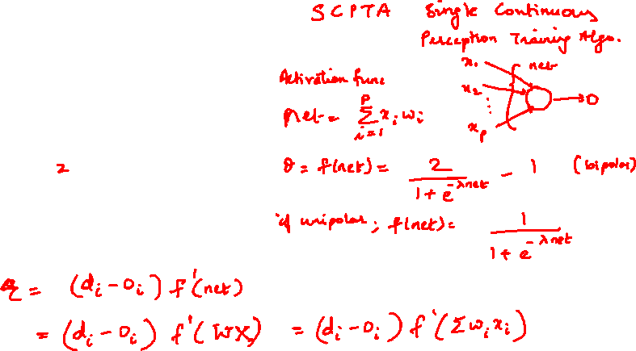

Slide 9
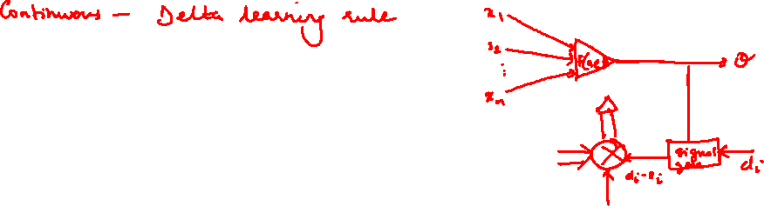

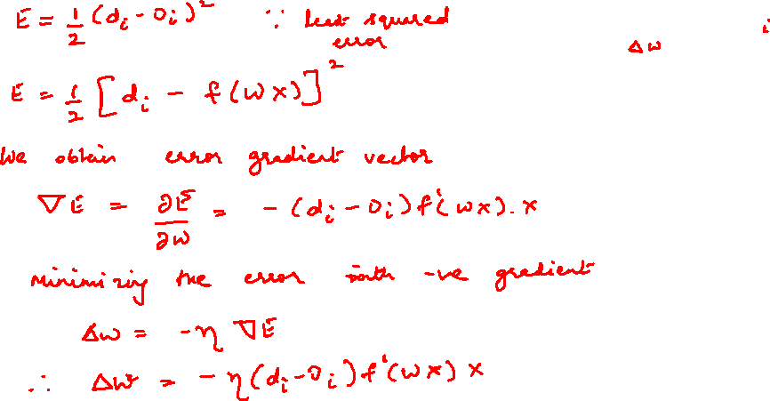
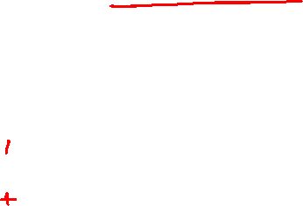

Slide 10
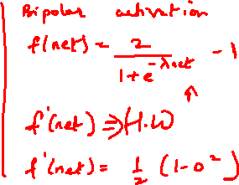
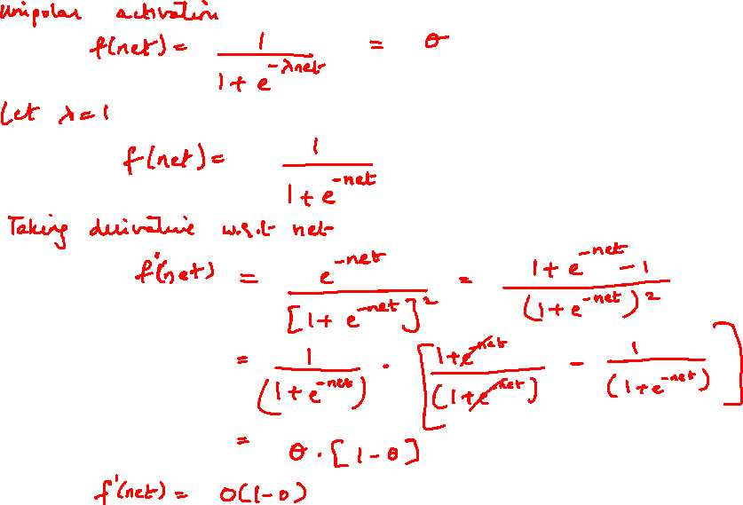

Slide 11
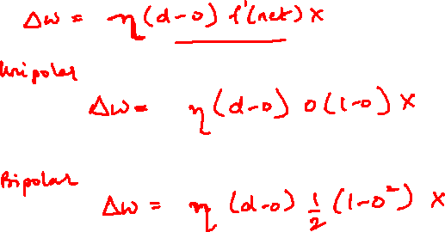

Slide 12
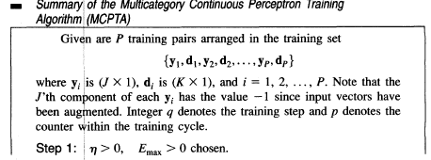
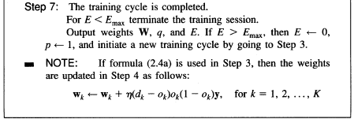
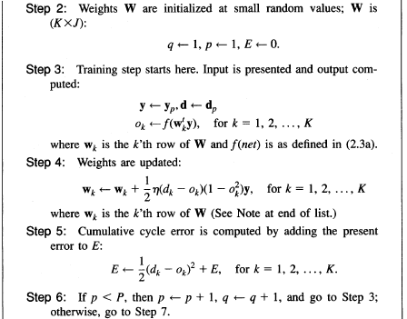
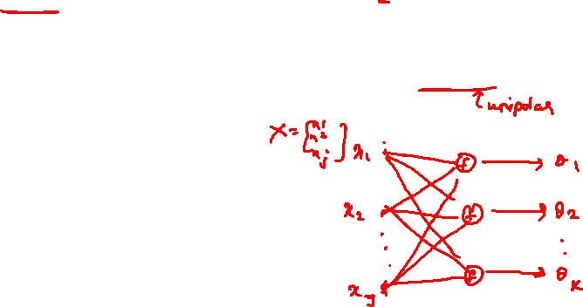

Slide 13
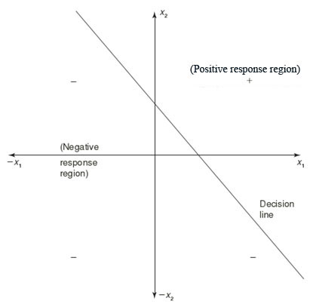
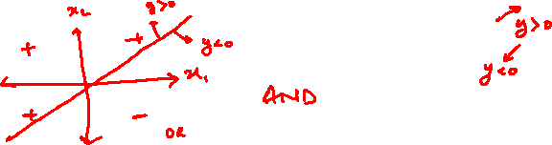
LINEAR SEPARABILITY
Linear separability is the concept wherein the separation of the input space into regions is based on whether the network response is positive or negative.
Consider a network having positive response in the first quadrant and negative response in all other quadrants (AND function) with either binary or bipolar data, then the decision line is drawn separating the positive response region from the negative response region.

Slide 14
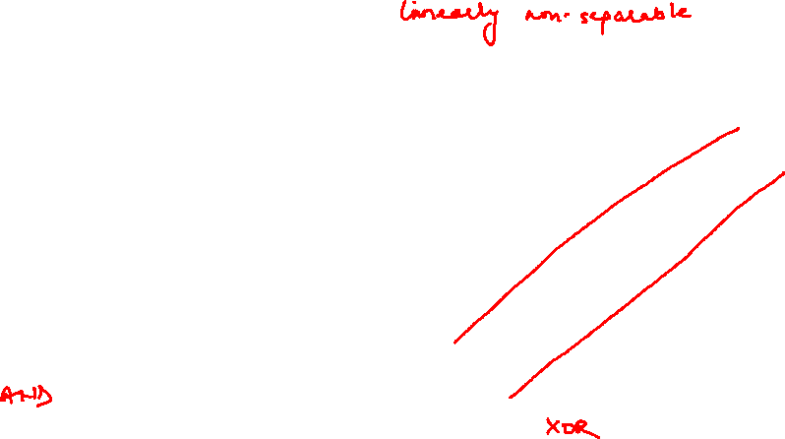
LINEAR SEPARABILITY
Now Consider a network with XOR function.
x2
+
-
x1
-
+

Slide 15
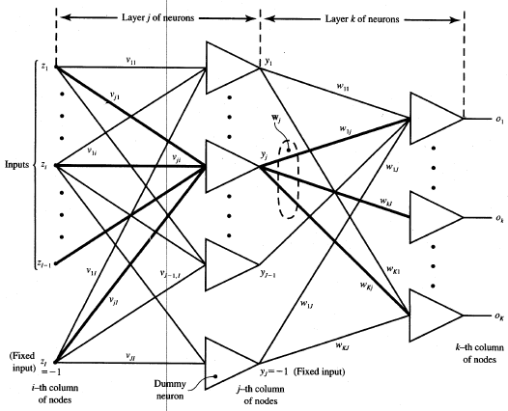
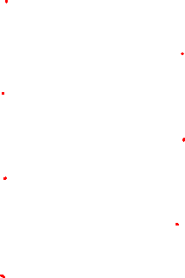

Slide 16
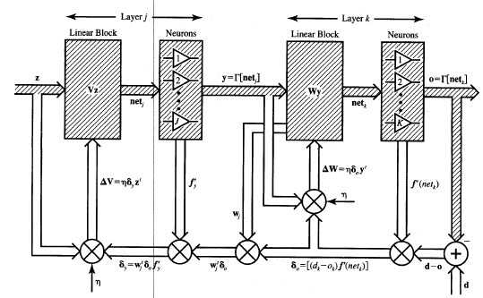
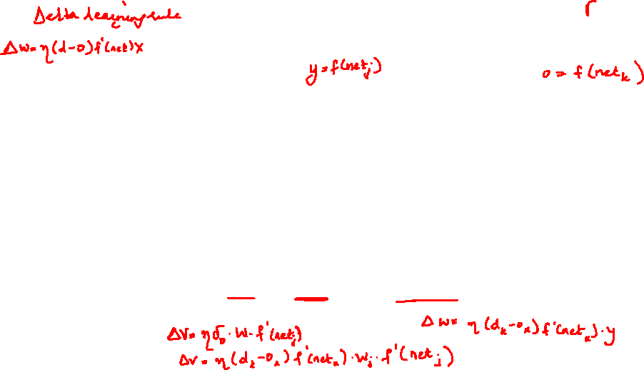
Feedforward Recall and Error Back-Propagation Training Algorithm

Slide 17
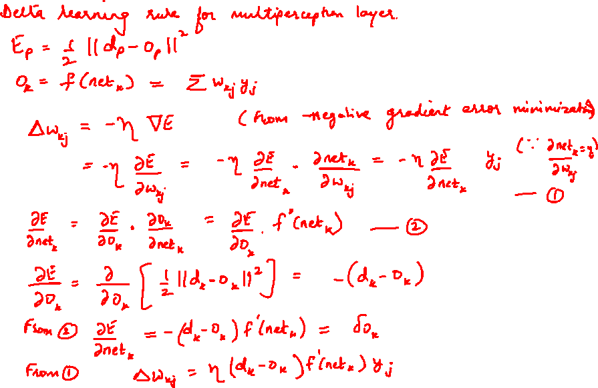

Slide 18
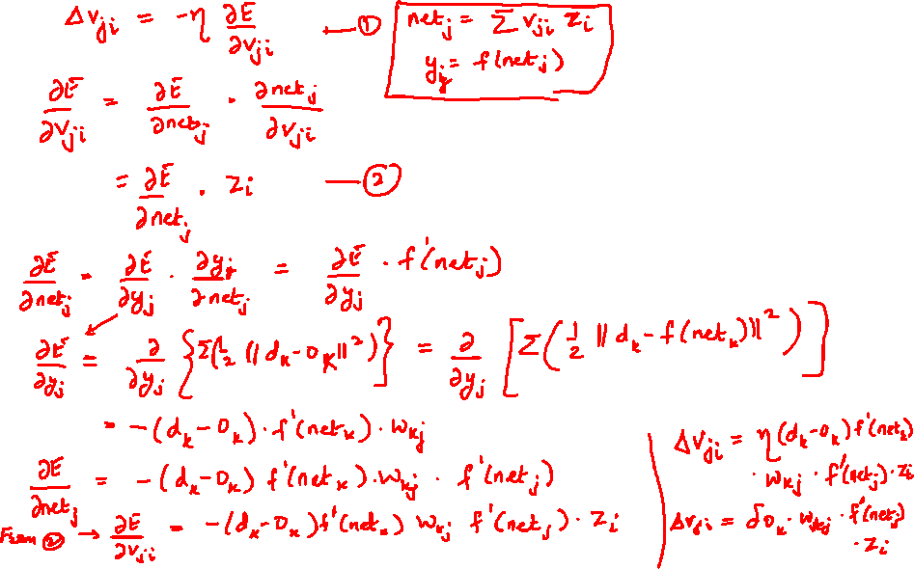

Slide 19
UNSUPERVISED LEARNING
No help from the outside.
No training data, no information available on the desired output.
Learning by doing.
Used to pick out structure in the input:
Clustering,
Reduction of dimensionality → compression.
Example: Kohonen’s Learning Law.

Slide 20
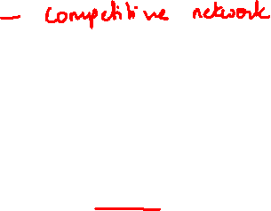
UNSUPERVISED LEARNING
Competition - Winner take all
Unsupervised – neural net seeks to find patterns or regularity in the input data
Clustering nets –
no. of input units = no. of components in input vector
No. of output units = no. of clusters
Weight vector for an output serves as exemplar for input patterns placed in the cluster
During training, the net determines the output unit that is the best match for the current input vector and the weight vector for the winner is adjusted according the learning algorithm.
W(new) = w(old) + α[x – w(old)]
Determining the closest weight vector to a pattern vector
Euclidean distance – between weight vector and input vector
Dot product – of weight vector and input vector

Slide 21
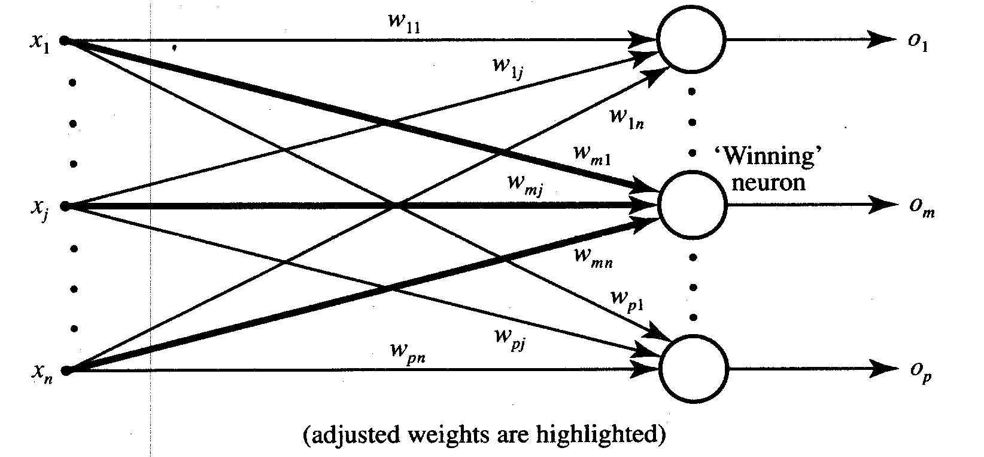




Winner-take-all learning rule
Identifying the Winner neuron
or
weight change for Winner neuron
Winner neuron

Slide 22

SELF-ORGANIZING NETWORKS
Discover significant patterns or features in the input data.
Discovery is done without a teacher.
Synaptic weights are changed according to local rules.
The changes affect a neuron’s immediate environment until a final configuration develops.

Slide 23
KOHONEN SELF-ORGANIZING FEATURE MAP (KSOFM)
Feature mapping : Converts the patterns of arbitrary dimensionality into a response of 1-D or 2-D arrays of neurons.
Networks performing such mapping is called feature map.
Capability to preserve the neighborhood relations of the input patterns i.e. topology preserving
M – output cluster units arranged in 1-D or 2-D array
Input signals are N – tuples
Weight vectors of cluster units serve as an exemplar vector
Self-organization:
the weight vector of the cluster unit which matches the input pattern very closely is chosen the winner unit.
Weights are updated for winning unit and neighboring units.

Slide 24
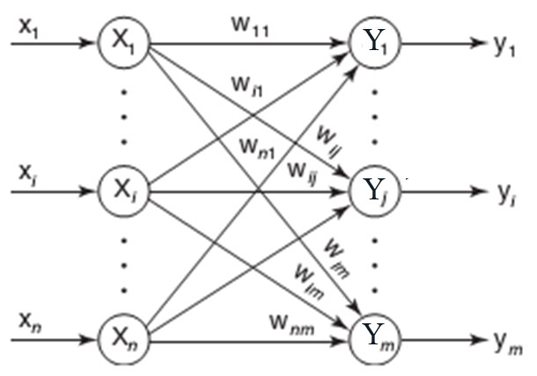
ARCHITECTURE OF KSOFM

Slide 25
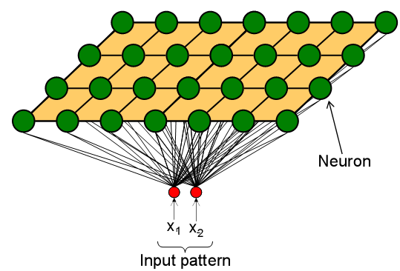
COMPETITION OF KSOFM
Each neuron in an SOM is assigned a weight vector with the same dimensionality N as the input space.
Any given input pattern is compared to the weight vector of each neuron and the closest neuron is declared the winner.
The Euclidean norm is commonly used to measure distance.

Slide 26
CO-OPERATION OF KSOFM
The activation of the winning neuron is spread to neurons in its immediate neighborhood.
This allows topologically close neurons to become sensitive to similar patterns.
The winner’s neighborhood is determined on the lattice topology.
Distance in the lattice is a function of the number of lateral connections to the winner.
The size of the neighborhood is initially large, but shrinks over time.
An initially large neighborhood promotes a topology-preserving mapping.
Smaller neighborhoods allow neurons to specialize in the latter stages of training.

Slide 27
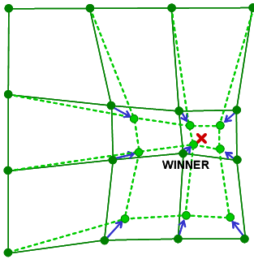
ADAPTATION OF KSOFM
During training, the winner neuron and its topological neighbors are adapted to make their weight vectors more similar to the input pattern that caused the activation.
Neurons that are closer to the winner will adapt more heavily than neurons that are further away.
The magnitude of the adaptation is controlled with a learning rate, which decays over time to ensure convergence of the SOM.

Slide 28
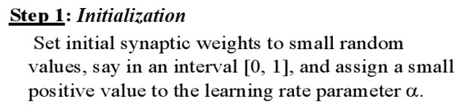
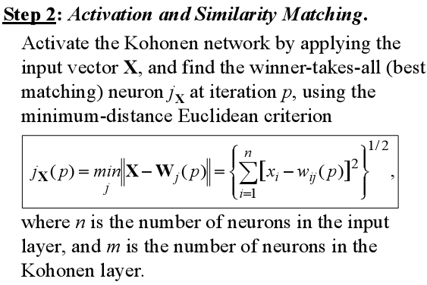
KSOFM ALGORITHM

Slide 29
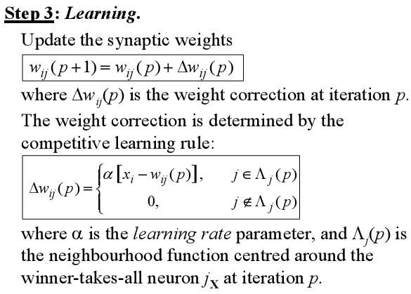
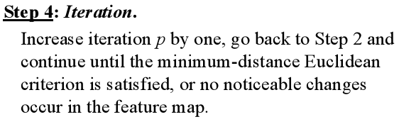

Slide 30
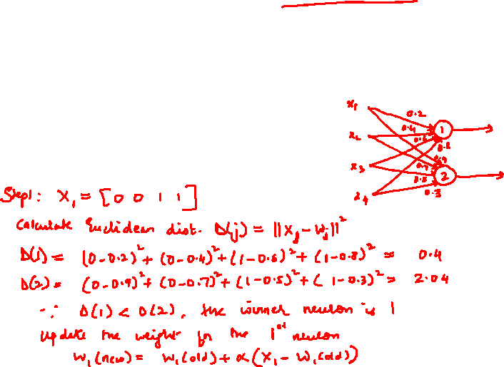
Construct a KSOFM net with two cluster units and four input units. [0 0 1 1], [1 0 0 0], [0 1 1 0], [0 0 0 1]. Assume initial learning rate of 0.5
The weight vectors for the cluster units are given by
w1 = [0.2 0.4 0.6 0.8]
w2 = [0.9 0.7 0.5 0.3]

Slide 31
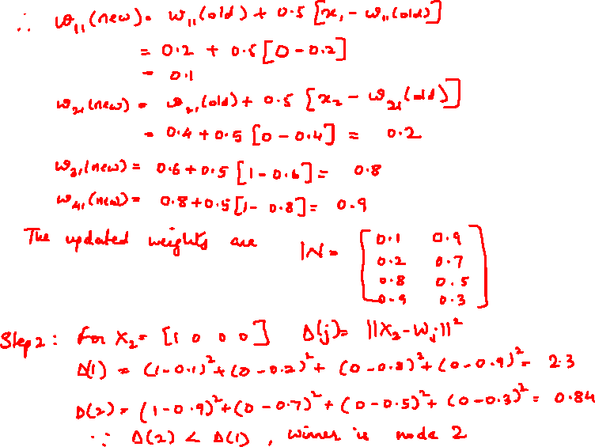

Slide 32
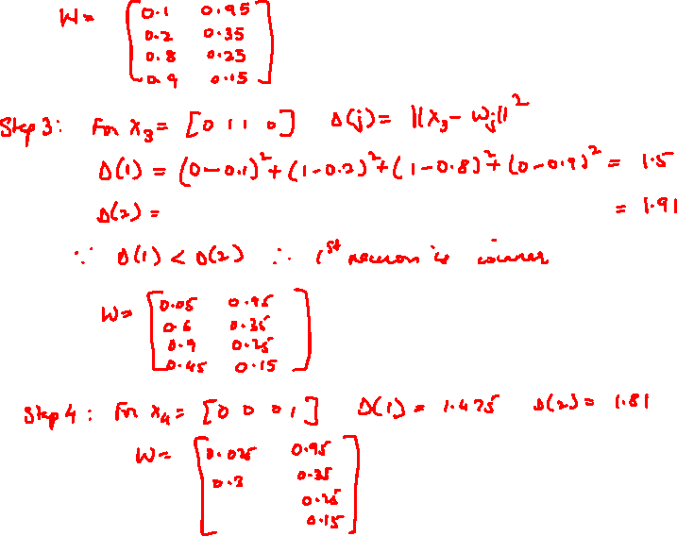
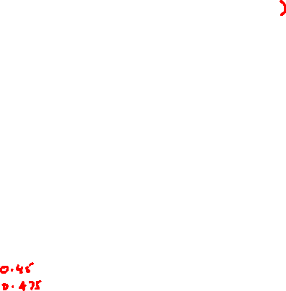

Slide 33
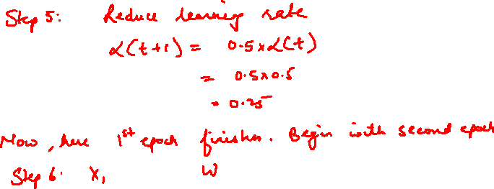

Slide 34


FEW APPLICATIONS OF NEURAL NETWORKS

